Slide 1
Anti-Sepsis
A post surgical daily solution
Notes:
title page

Slide 2




Team Members
06
Siqi Wang
Xinyi Shang
Huachen Shan
Zhiheng Shi
Master student of biostatistics in the Columbia University Mailman School of Public Health
Master student of biostatistics in the Columbia University Mailman School of Public Health
Master student of biostatistics in the Columbia University Mailman School of Public Health
Master student of biostatistics in the Columbia University Mailman School of Public Health

Slide 3
Sepsis
bacterial
viral
fungal
antibiotics and large amounts of intravenous fluids
First
fever
rapid heartbeat
rapid breathing
Second
Third
Fourth
Symptoms
Causes
prevention

Slide 4
What is the harm of sepsis?
30%
1.10%
1.18%
2.1%
Post-operative
Sepsis
Cancer
Heart DIsease
The main cause of post surgical death was sepsis (30.02%)
Sepsis is the third common cause of death in U.S. hospitals[2]
About 602,347 people in the United States died from cancer in 2021 (CDC)
About 695,000 people in the United States died from heart disease in 2021 (CDC)
[1]DOI: 10.1016/j.surge.2013.07.005
[2] By Bridget Balch, Staff Writer

Slide 5
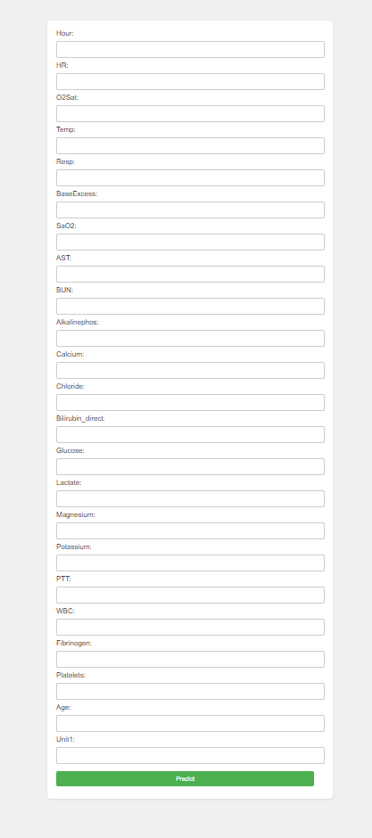

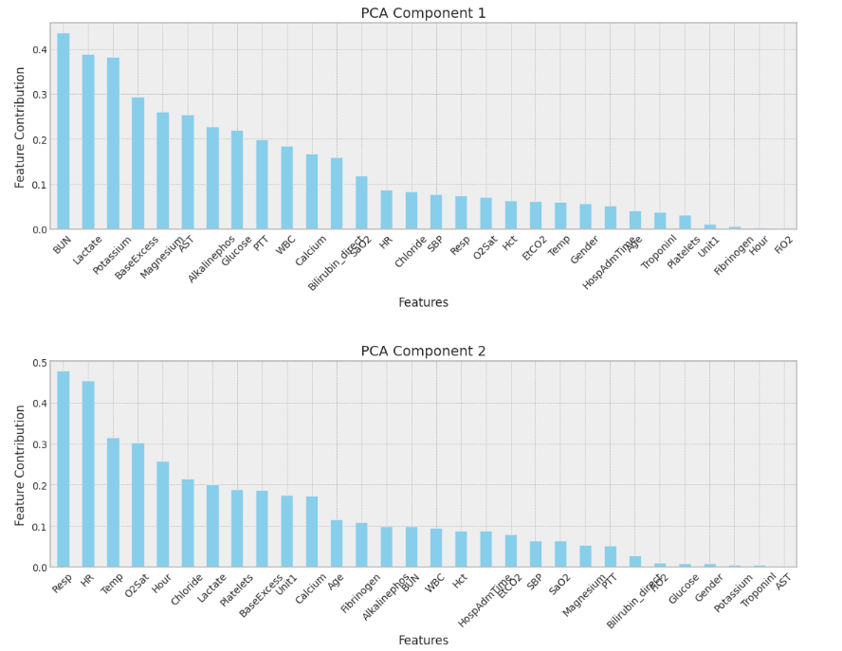
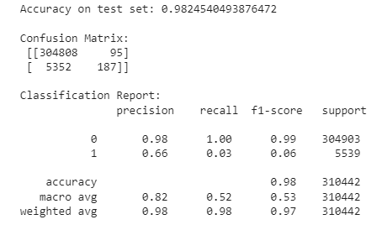
Data Gathering
App
Publication
Key Predictor
Identifying
Model Training
Reyna, M., Josef, C., Jeter, R., Shashikumar, S., Moody, B., Westover, M. B., Sharma, A., Nemati, S., & Clifford, G. D. (2019). Early Prediction of Sepsis from Clinical Data: The PhysioNet/Computing in Cardiology Challenge 2019 (version 1.0.0). PhysioNet. https://doi.org/10.13026/v64v-d857.
Notes:
explanation of the model, early detention (late detection may lead to systematic disorder / kidney injury, etc.) data output

Slide 6
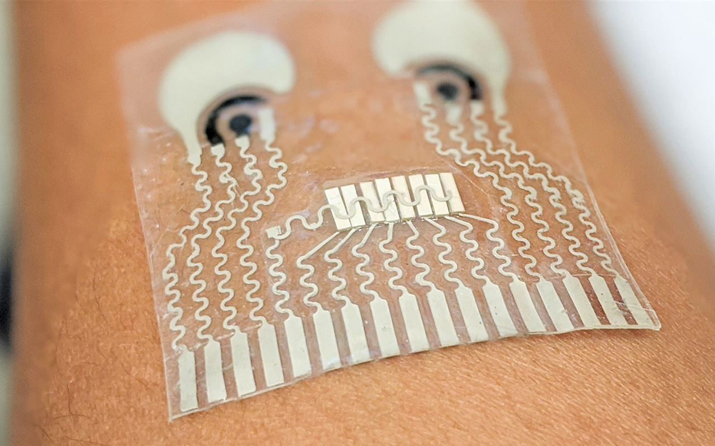
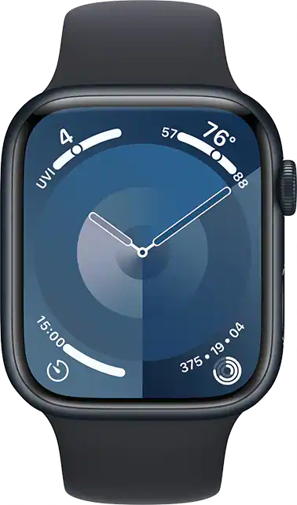
Application of our Research
Creating a health tracker device that can show patients complete blood count, lactate level, and other biochemical markers.
Health Tracker
Categorized those data based on current sepsis testing standard, to judge whether the patient is healthy or susceptible population.
Data Visualization
Based on the previous judgement, the device will provide patients with therapy and recovery plans on the screen.
Healthcare Suggestions
Notes:
potential buyer

Slide 7
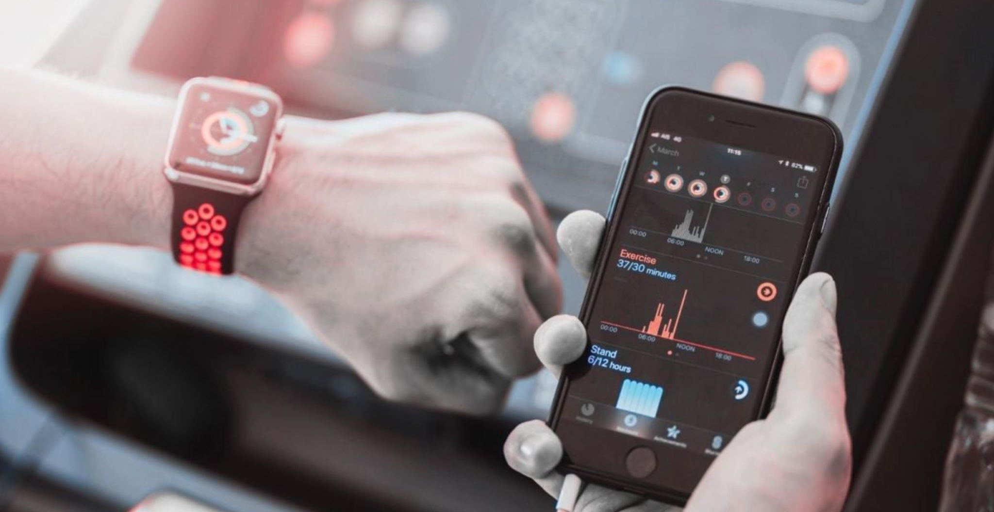
Questions？
Thank you！

